Slide 1
Flipping trials
with Belinda Amis Wheaton

Slide 2
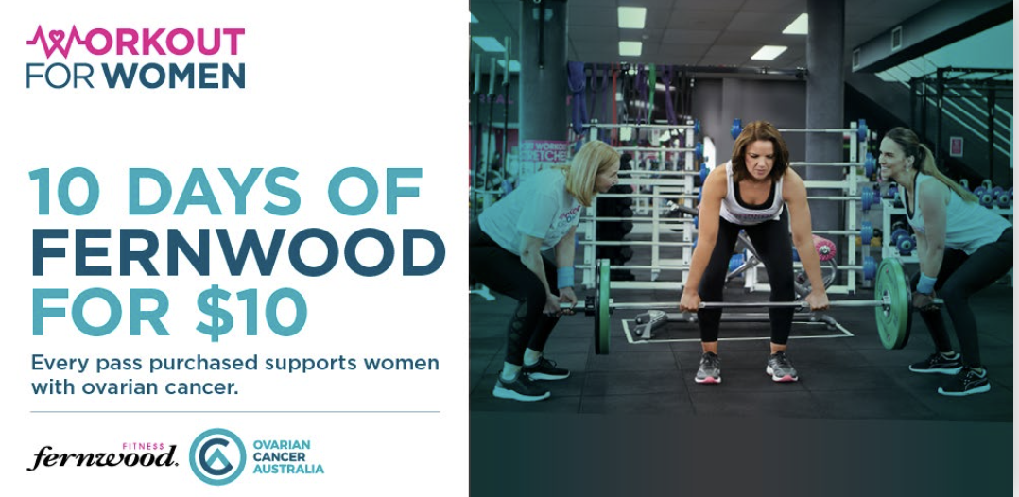
In November
Fernwood are joining forces with Ovarian Cancer Australia (OCA). National promotions of the $10 for 10 day trial pass commence on October 22nd.

Slide 3
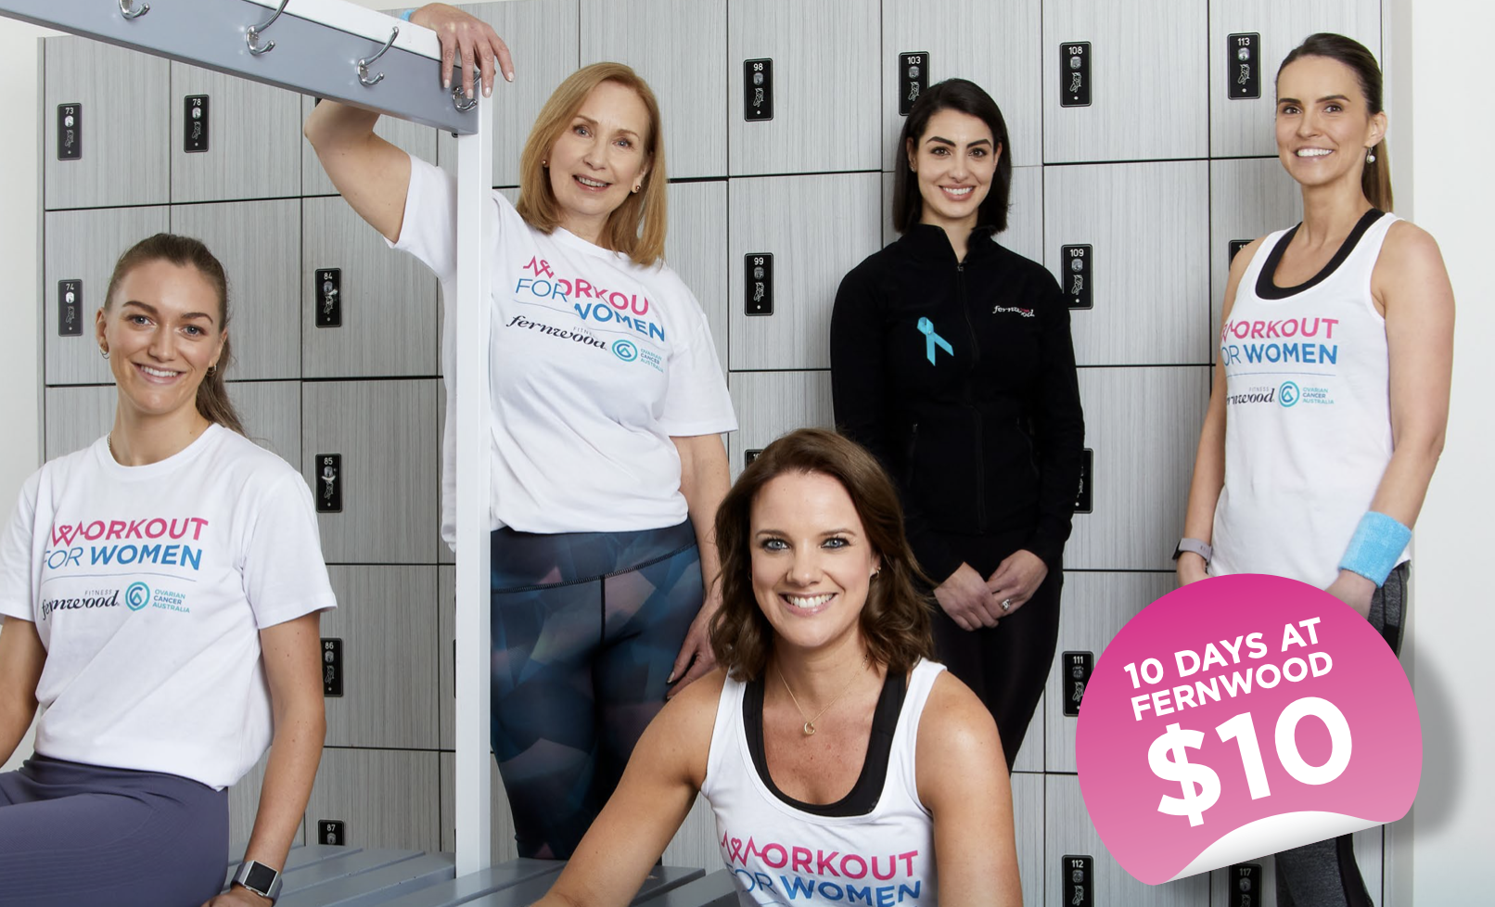
Workout for woman campaign webinar
Join the webinar next Wednesday as Caitlin and Alison go through everything you need to know about the upcoming OCA November campaign.
Ovarian Cancer Australia November Campaign Wed, Oct 21, 2020 1:00 PM - 1:30 PM (AEDT)

Slide 4
As we lead in to the OCA November campaign..
It’s a perfect time to brush up on our
“trade in” skills
and maximize the opportunity that each trial pass presents.

Slide 5
Todays webinar
Is designed to provide you with helpful tools to assist you to convert trial membership passes to paying members.
POS opportunities – BEFORE activating
Trial memberships – AFTER activating

Slide 6
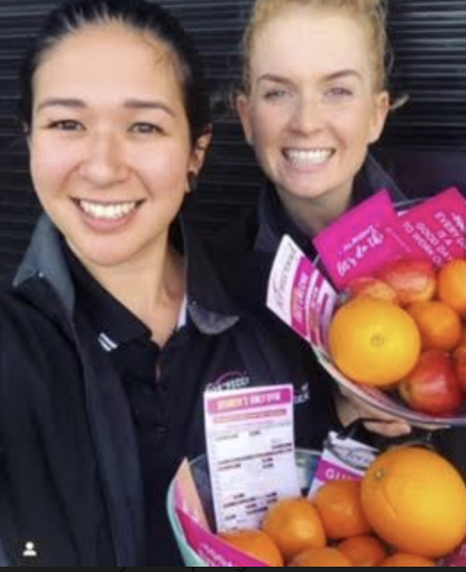
Todays webinar
Tips and tools discussed today are relevant for flipping ALL kids of trial passes:
3/5/7/10 day pass
Paid and unpaid

Slide 7
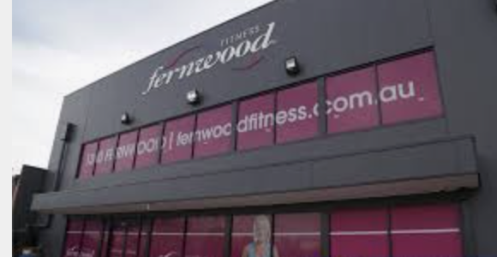
Trial passes are an effective marketing tool
That can drive more women to your front door.
However,
Trial passes are NOT a sales tool.

Slide 8
What is your clubs objective relating to trial passes?
Effective marketing of trial passes = woman coming in to experience the Fernwood difference.
Unfortunately, without a strong trade in process at POS, these passes become activated.
Current statistics display that just 10-15% become members during and after their trial.
50 trial passes to your door in a month = Just 5 new members (converted at 10%)
Effective marketing of trial passes COMBINED with effective sales processes = MORE NEW MEMBERS
A strong trade in culture results in much higher conversions.
50 trial passes to your door in a month could result in 25 new members
(example only, converted at 50%)

Slide 9
Understanding these different conversions is is a game changer.
Do you want to convert trial passes at 10% or 50%?
It’s a team effort – share the vision.
This may take some time and energy…
It will be well worth it ☺

Slide 10
Take a moment to consider…
Does your club love marketing that drives trial passes?
How do YOUR team members view trial passes?
Do they see them as golden opportunities?
Do we need to shift our mind around towards trial passes?
How can you do that?
How will you know if it works?

Slide 11
Worth a conversation…
Is NOT mentioning the trial pass on the phone or in person a good idea?
Should we pretend that the prospect does not have it?
Should the emphasis be on the prospects goals? 100%
What happens if we don't mention the pass?
Does the prospect feel heard?
Do they feel like the pass is a waste of time as it’s unrecognized?
What happens if they don’t join today and they want to activate their pass?
Have we got a better chance of maintaining integrity and converting to membership when we are transparent and have an EXCLUSIVE offer?

Slide 12
Great results
Great results occur for our members when they enjoying full membership privileges not a quick fix short term trial pass.
We owe it to all woman to guide them to a membership that is best suited to their goals.

Slide 13
Let’s talk Trade In
What is a trade in?
Trading the trial pass (paid or unpaid) for an exclusive paid membership offer .

Slide 14
Attach appointments to EVERY trial pass
Without this appointment you may miss the TRADE IN opportunity.
Whenever advertising trial passes in print, giving them out at outreach or internally to gain referrals, ensure there is a call to action and expiry date on the pass.
“Call the club on 9458 3356 to secure your trial offer. Expires Nov 30th 2020”
If generating trial pass leads on line, the leads will hit your CRM and should be called as soon as possible. Follow the call flow and ensure the 6 calls are made across the first few days.
Like any leads, timing is important and should be called at our earliest convenience.

Slide 15
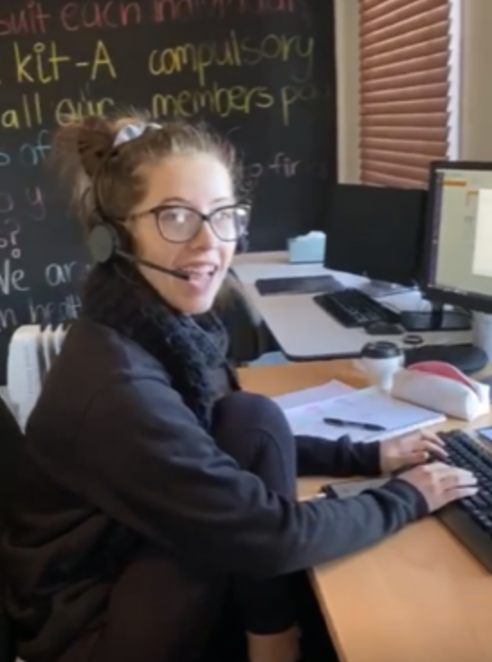
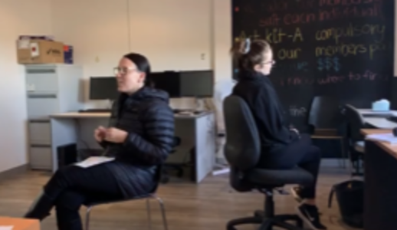
The phone call - outgoing
Hi Vicki,
Its Belinda calling from Fernwood in Ascot Vale. I’m just touching base because I can see that you are have purchased a 10 day pass for $10. Is that right? Fantastic!! You are not only supporting a great cause but doing something to support your own health and wellness. Do you mind if I ask if you are doing any kind of exercise at at the moment?
Normal scripting to create rapport and qualify the lead.
(Role play)
Plant the seed only AFTER securing the appointment.
“I can’t wait to see you on Thursday. I’m looking forward to learning more about your health and wellness goals and showing you around the club. Then, if you are happy with everything that you see I will be able to show you a great way that you can trade in your trial pass and receive lots of membership savings and privileges. How does that sound?”
Your aim is for your prospect to feel excited rather than pressured. Use your tone and language to convey the correct message.

Slide 16
The phone call - outgoing
Planting the seed during the phone call is an important step in this process.
It gives the prospect something to think about.
They know what to expect when they arrive at the club.
It makes it so much easier for the person touring as the “scene has been set”.
Consider how your club handles this type of incoming call. Do you pass the call to a membership consultant? If not, all customer service team members need to understand the preferred language to be used.

Slide 17
The appointment - Greeting
You have to be confident that the “seed was planted” when the appointment was booked.
“Thanks for coming in today Vicki. As we mentioned on the phone, what we will do today is have more of a chat about your health and wellness goals and then I will show you around the club. If you are happy with everything you see, I’ll be able to show you a great way that you can trade in your 10 day pass and receive lots of membership savings and privileges. Let’s take a seat, I’d love to hear more about you...”.
The prospect has now heard about the trade in twice. Perfect!

Slide 18
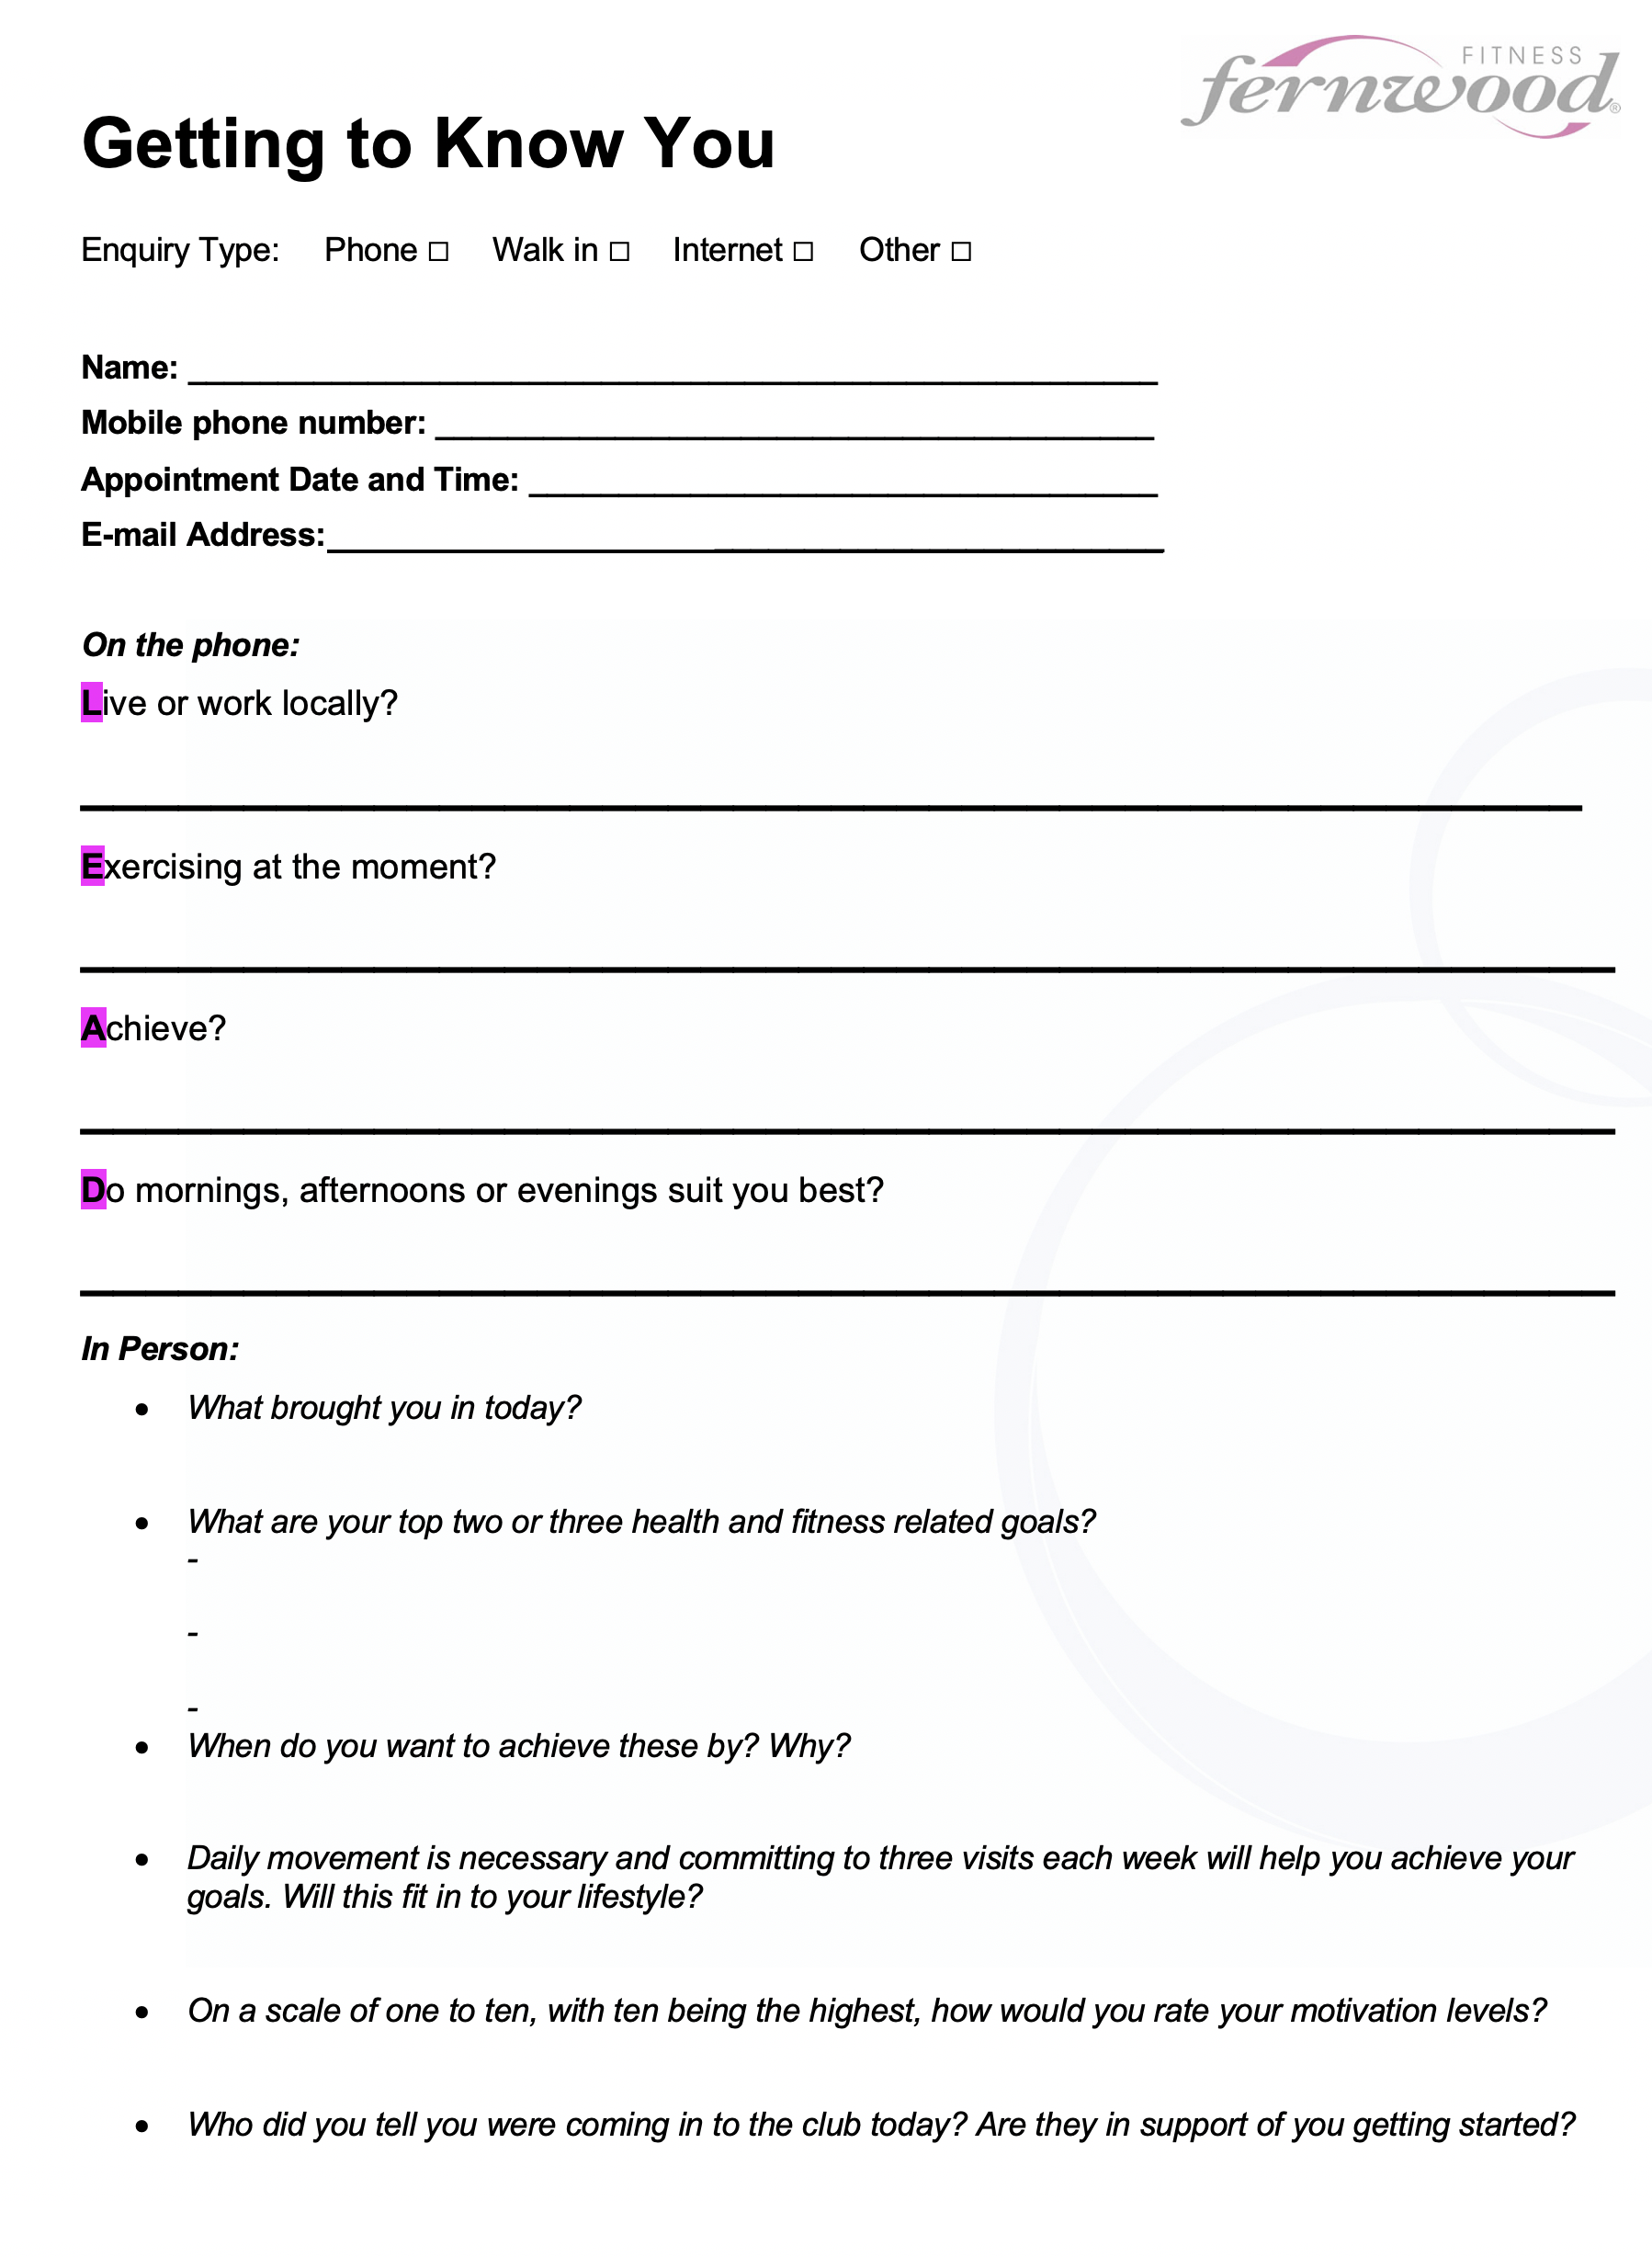
The appointment – needs & tour
Treat everyone with respect for seeking interest in your club and ensure you take the time to do a full needs analysis to see how you can help each woman achieve her goals.
This part of the process is EXACTLY THE SAME as every other appointment.
Take the same amount of time as you usually would and don’t cut corners.

Slide 19
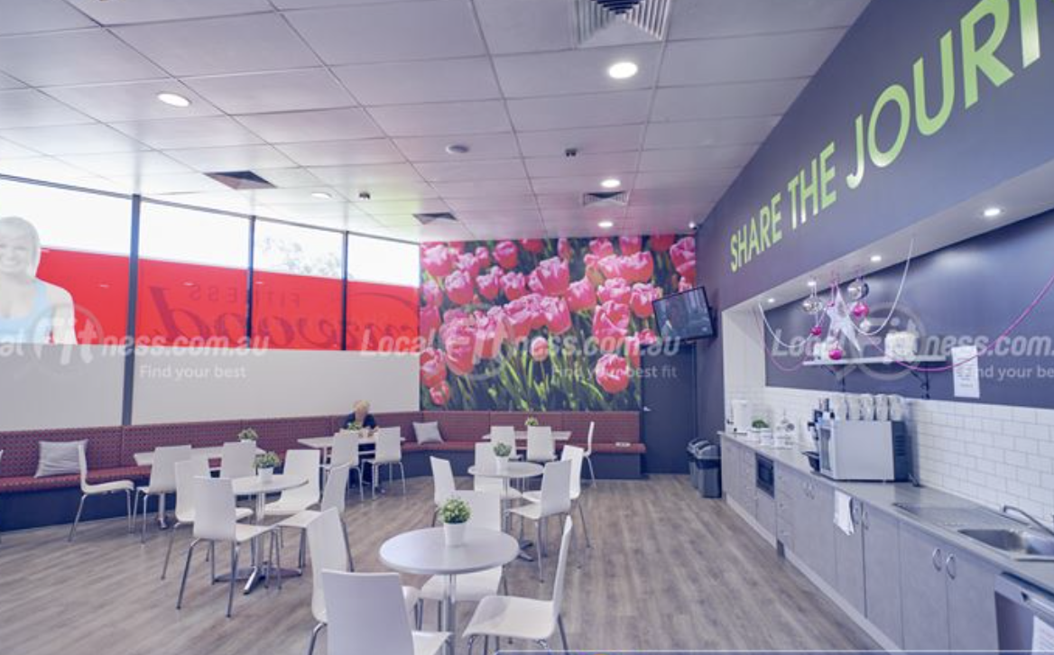
The appointment – on the way back to the members lounge
What do you think of the club?
Can you see yourself working out here?
Does it have everything that you are looking for?
“Fantastic, well come and take a seat and I’ll show you through the trade in option and help you get started….”

Slide 20

Price preso - What is your clubs trade in offer?
Will you use a price presentation card, hand write at POS or simply talk through the
trade in? Whichever is your preferred option make sure that all team members are
clear on the offering. Roleplay, roleplay, roleplay.
Make sure your trade in offer is congruent with your clubs business objectives.
If you wish to increase FIIT 30 absorption, perhaps include that.
If you want to promote your infrared sauna, perhaps add that.
What products or services can you include that are desirable but
low cost to the business?
Be sure to tie in the prospects goals to your close. “I know it’s important for you
to lose the 5 kg’s you’ve gained this year so I recommend you trade in your
pass on our 12 month minimum term membership. Here is how it works..”
Use the urgency of TODAY ONLY.
The close is about the woman sitting in front of you, not the pass.

Slide 21

Language for the OCA $10 for 10 day pass...
“The $10 paid for your 10-day pass is a 100% donation to OCA, we are aiming to raise $50K for OCA this month and you are now an important part of this! In addition to this fundraising support, I have a special offer for you today from Fernwood to thank you for supporting our partnership with OCA. If you choose to “trade in your 10-day voucher today...”

Slide 22
Make your trade in too good to refuse!
There is a lot more to be gained than lost.
If you don’t trade in at POS, you have now dropped to a 10 – 15% chance of converting this woman to a membership. Knowing this makes a big difference.
Trade in offers will differ from club to club and will change from time to time in line with seasons, business objectives and marketing.
The goal is to add as much value as possible to your trade in, so it is by far the most attractive option. Much more attractive than commencing a short trial.

Slide 23

Trade in success
Don’t forget referrals ☺
Hand the pass over to a friend now you are a member? Free 7 day passes for friends?
Double the OCA donation when you refer a friend?

Slide 24
Trial passes without an appointment.
Whilst it is certainly preference to attach an appointment to every trial pass, it may occur that women simply come in with the pass without an appointment.
Treat EVERY walk in like Gold!!
If this happens often, try and back track where the passes are coming from and implement a process to ensure appointments can be booked.
Did you give out passes without a call to action? Easy fix.
Are your members giving out passes and not letting their friends know to book first? Easy fix.
Try to minimize the amount of passes coming in without appointment.
Rather, try to maximize the amount of passes coming in WITH appointments.
It is in your best interest to NOT activate any passes until the woman has completed a needs analysis/tour/trade in price preso

Slide 25
Trial passes without an appointment.
Do not get in to the habit of activating a passes without an appointment.
Give them a WOW experience but don’t activate the pass.
“Thanks so much for coming in today Lisa. I see you’ve have purchased the $10 pass and would like to do the spinning class in 5 minutes. As I don’t have anybody available to show you around right now and the class is in just a few minutes, here’s what we’ll do…
I’ll get you to fill in a health screen and I will let you do a COMPLIMENTARY WORKOUT today.
I wont activate your 10 day trial because if I do you will lose all of the savings that are attached to the pass. I will make a time for you to meet with a membership consultant and they can explain how our trade in offer works and how you can save over $400. Will a morning, afternoon or evening suit you best?”
It would be great if there was a team member available directly after the class to meet with the woman. If not, they have an appointment and have hopefully been WOWED by their experience today.

Slide 26
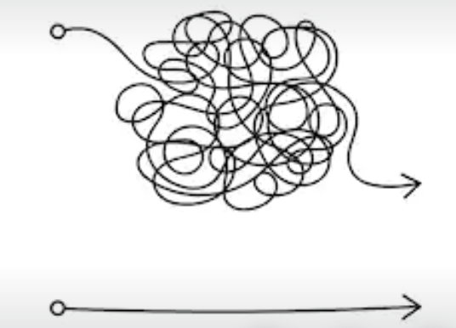
Once activated
Once a trial pass is activated, still aim to convert to membership.
You may need to work harder at this conversion now.…

Slide 27
Once activated
A solid plan – what is the offer?
Perhaps not as strong as the trade in offer but still attractive.
If your trade in offer is to save $400, maybe joining before the end of the activated trial will allow them to still save $300.

Slide 28
Once activated
Follow up phone calls, video messages, SMS – urgency, call to action. Desired outcome = membership.
Trials report in Exerp for all active trials in a certain date range and includes the below fields
Member Name
Member ID
Mobile number
Email address
Trial name
Trial load date (date entered into Exerp)
Trial start date
Trial end date
Subscription status (Active, Ended, Created)
It’s in Exerp > Reports > Extract Wizard > Franchisee > Trial Report > Enter start and end dates of the date range you want to see > Next > Right click and export to Excel.

Slide 29

Good luck
Once your team understand the golden opportunity that sits within every trial pass, it’s exciting to then develop marketing to specifically start generating these kinds of leads.
I look forward to seeing all of your trial pass conversions soar as a result of a strong trade in culture.
Belinda Amis Wheaton
0433 100 929
belinda.amis@fernwoodfitness.com.au

